Slide 1
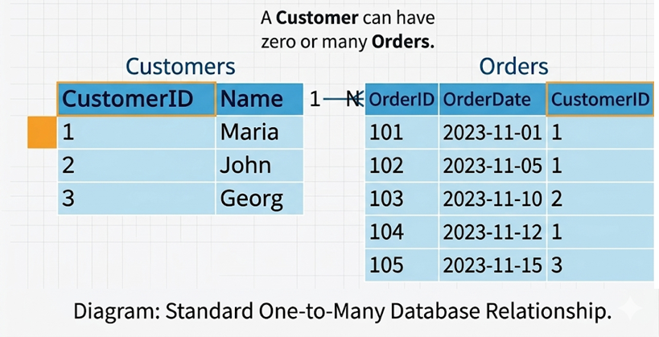
Relationships:
One-to-many
One to One
Many to Many
One-to-many

Slide 2
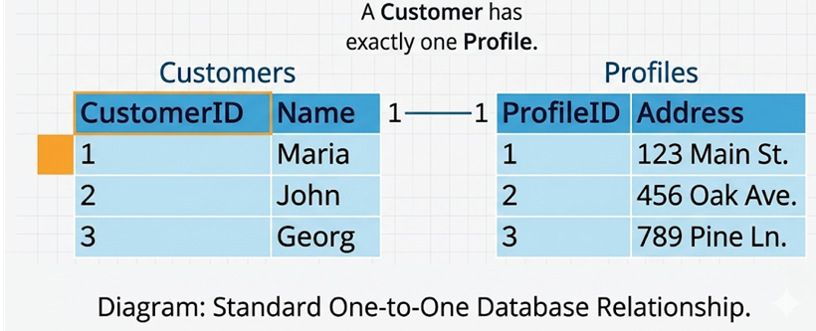
One-to-One

